Slide 1

PSY4013 – Intro to Social Psychology
5: Challenges to Social Psychology
Lukas Wallrich (l.wallrich@gold.ac.uk) | November 2019 .

Slide 2

Our plan for today
Challenges to quantitative social psychology: critical approaches
Challenges to quantitative/ experimental social psychology: the replication crisis

Slide 3
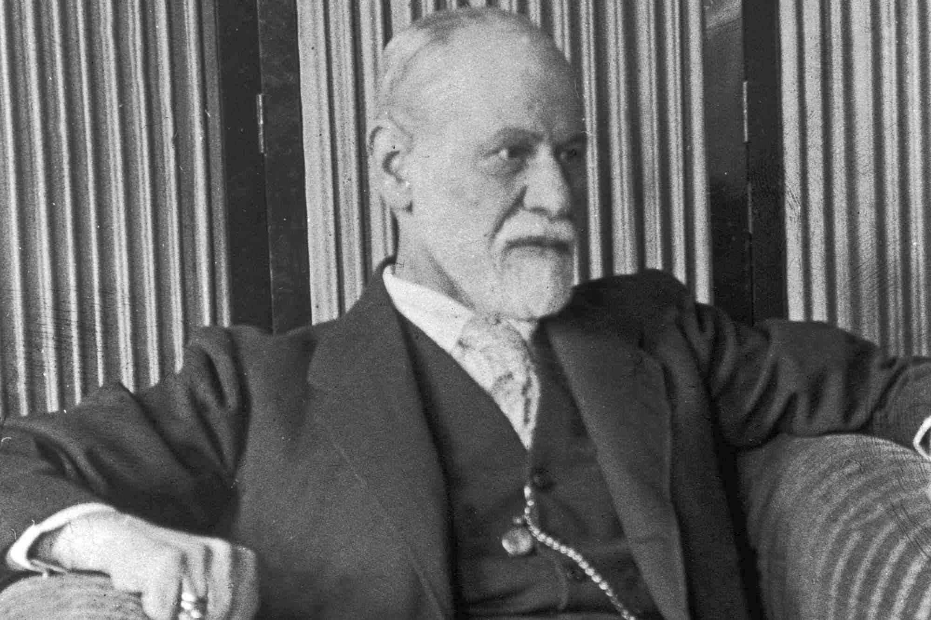

Psychology as a science
Psychology started in 19th century, focus on questions that philosophers spent 2,500 years on
So: out of the armchair, into the scientific method

Slide 4
Assumptions of quantitative research
Ontology (what exists?):
Things we want to study exist objectively
There is an objective truth about relationships
Those relationships are somewhat universal
→ Realism
Epistemology (how can we know?):
Can divide things into discrete categories, or describe them by small set of variables
Can get progressively closer to truth through the scientific method

Slide 5

So social science is about:
Unbiased systematic observation
Developing hypotheses and making progress through falsification
Generation of objective facts and general laws (‘human nature’)
Strive for causal explanation (thus need for control and experiments)

Slide 6

The qualitative critique
Is there really an objective reality where “prejudice” and “beauty” exist?
Or are we collectively creating these things through language? (Social constructionism)
Can we study individuals in an unbiased lab? Or are we always located in society?
Can there be a neutral observer? Or are there always power dynamics (race, gender, class, disability, sexuality …)?

Slide 7

Task in threes: scientific psychology
4 minutes to discuss
Can human activity be captured sufficiently by scientific methods (e.g., experiments, questionnaires)?
Can you give examples of behaviours that you think can and cannot be measured and predicted?
Decide on one person to report back

Slide 8

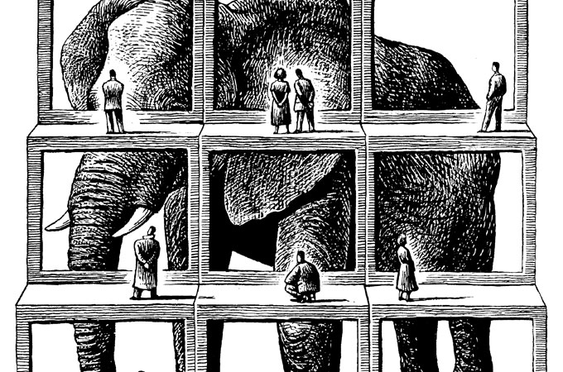
What happens in a lab?
Unusual setting where individuals have a very special social role: “subject”
So schema is to be compliant and show no initiative
Outside the lab, issues are always in a specific context
So what can lab experiments contribute to our understanding of real-life processes? (Ecological validity)
Notes:
“Subject” is the historical name – partly in response to the criticisms, we now have to say “participants”

Slide 9
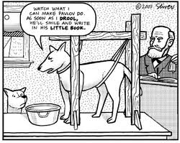
Demand characteristics:
participants have expectations and/or read cues about what is expected, how they are supposed to act
Experimenter bias:
knowledge of the research hypothesis may subtly and unintentionally influence how participants are treated
→ Need for double-blind experiments where possible

Slide 10

Narrow participant pool (See: McVittie & McKinley, 2008)
Traditional psychological research often conducted on undergraduate psychology students
Easy access, financial reward, course credit
Why might that be a problem?
They (we) are from WEIRD backgrounds –White, Educated, Industrialised, Rich and Democratic countries
And, not real adults (see Emerging Adulthood), in a setting that promotes compliance
Notes:
Tend to be more educated, better cognitive skills, more compliant, narrow age range, wealthier.
https://slate.com/technology/2013/05/weird-psychology-social-science-researchers-rely-too-much-on-western-college-students.html

Slide 11
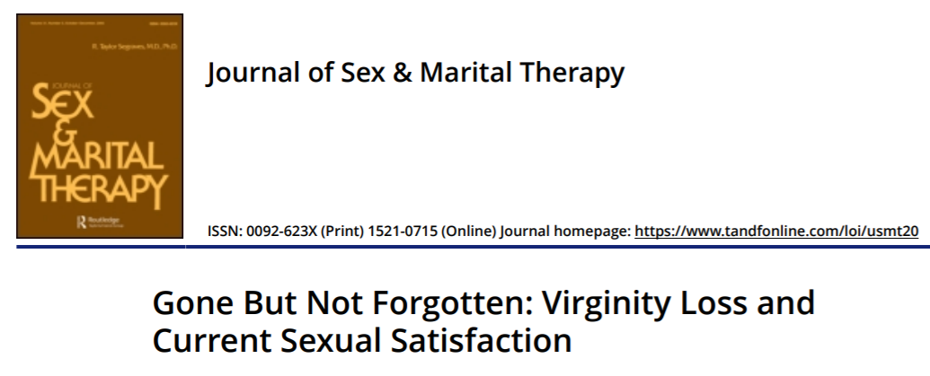
An extreme example

Slide 12
An extreme example
“These results suggest that one’s first-time sexual experience is more than just a milestone in development. Rather, it appears to have implications for their sexual well-being years later” (Abstract)
319 psychology students, mean age 18.9
Mean age of virginity loss: 16.7 years
Duration of study: 2 weeks
Participants filled in questionnaire about virginity loss at start
Participants to fill in a questionnaire after each “intimate interaction” rating 23 dimensions
Notes:
https://slate.com/human-interest/2013/01/virginity-loss-study-does-your-first-time-scar-you-for-life.html

Slide 13
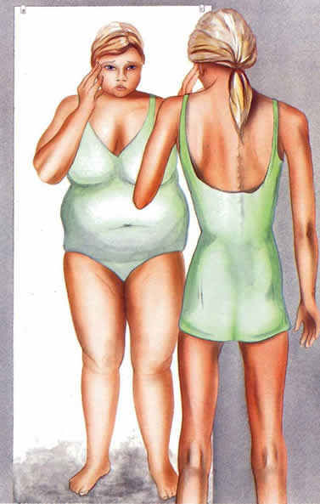
Criticism: Individualistic
Focus on individual as cause of problem
Goal of mainstream social psychology to fix the individual
e.g., fixing the personal psychology of anorexic girls
e.g., fixing the anxiety of individual students

Slide 14

So what’s the problem?
Individualism can encourage ‘victim blaming’
Critics would say: “We live in an oppressive and exploitative society – rather than challenge broad systems of social, cultural, economic and political inequality, psychology uses it knowledge to adapt people to its alienating conditions”
(read section about Marxism in Gough et al, 2013, ch.1)
Notes:
My research area – intergroup contact – has become more aware of that in recent years. “Let them eat harmony” – importance to both consider individual attitudes and systemic inequality

Slide 15
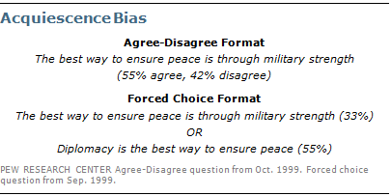
Criticism: Constraining choice
Quantitative measures force participants to select from a limited range of choices
Participants may never have considered phenomenon in numerical form, and answers are then easy to subtly influence / manipulate
Notes:
Might think the problem goes beyond this – maybe turning complex feelings into numbers just does not work

Slide 16
Criticism: Dehumanization
“Individuals become lost in the process of data collection… Numerical precision is achieved at the cost of meaningfulness” (Tuffin, 2005, p.47).
Summarising the victim of a rape or robbery as a statistic strips out the psychological significance and meaningfulness of the event (?)

Slide 17
An alternative view: Social Constructionism
Ontology: reality is socially constructed (goes against “realism)
“The way people think, the very categories and concepts that provide a framework for meaning for them are provided by the language they use” (Gough et al, 2013, p.14)
Language defines, produces or ‘constructs’ reality – more than one version of an event

Slide 18
The active role of language
Critique of mainstream view of language:
Language is not a transparent, passive, clear or pure medium through which our thoughts, feelings and internal states can be made available to others
Instead, language constructs reality, it does things, it has different effects and functions, it represents the world in particular ways.
Was Nelson Mandela a “freedom fighter” or a “terrorist”? [Short online lecture]
“Why are white people expats when the rest of us are immigrants?” [Guardian article]

Slide 19
Task in threes: media language
Watch the video clip and consider the ways in which language ‘constructs’ reality:
what are people doing with their talk?
what is the effect or the function of using specific words rather than others?
Decide on one person to report back

Slide 20
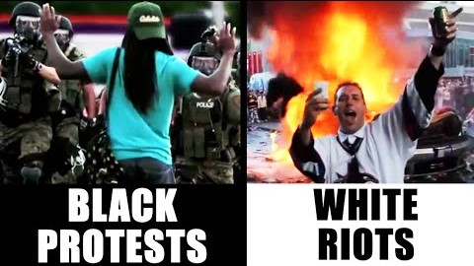

Slide 21
Task in threes: media language
Watch the video clip and consider the ways in which language ‘constructs’ reality:
what are people doing with their talk?
what is the effect or the function of using specific words rather than others?
Decide on one person to report back

Slide 22
Two ways of dealing with critiques
Become a critical social psychologist who
prioritises qualitative over quantitative data
prioritises advocacy over (impossible) neutrality as part of their research
Take them on board in mainstream social psychology
Consider social context of research
Consider role of language
Consider minority experiences
Be wary of WEIRDness in samples
Be respectful of participants and social impact of research

Slide 23
Some arguments to redeem quantitative social psychology
Has (relatively) clear standards to decide between competing theories
Ability to generate knowledge in cumulative process
Ability to decide empirically which findings are culturally specific and which are universal
Qualitative and subjective disciplines that focus on the role of social context exist – e.g., anthropology
Quantitative results are generally more likely to influence decision making

Slide 24
Our plan for today
Challenges to quantitative social psychology: critical approaches
Challenges to quantitative/ experimental social psychology: the replication crisis
Notes:
https://nobaproject.com/modules/the-replication-crisis-in-psychology

Slide 25
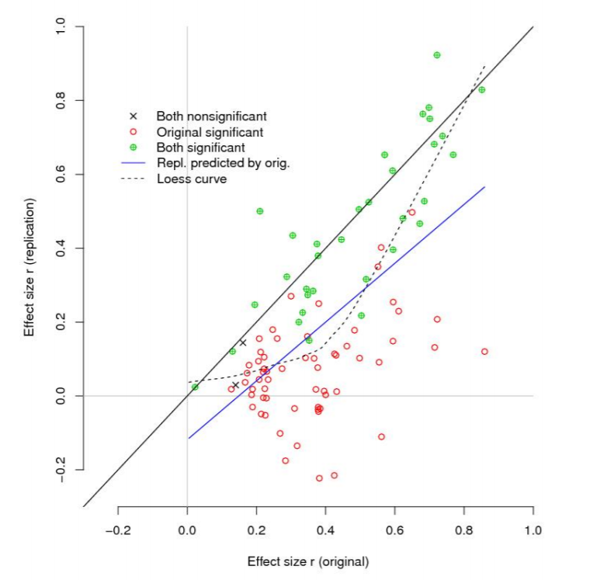
Replication crisis
“Reproducibility project” in 2015 replicated 100 studies … only 36% again yielded significant results
Replicated effect sizes were half those of original studies
Worst in social psychology with ~25% replication
Notes:
Many Lab 2 – published last year – had a success rate around 50% - with huge sample sizes

Slide 26
Some well-known theories that are in doubt or debunked
Ego depletion / decision fatigue
Social priming (e.g., warmth of drink = warmth of person)
Marshmallow test
Stereotype threat?
Notes:
https://www.vox.com/science-and-health/2018/8/27/17761466/psychology-replication-crisis-nature-social-science
Also, any good theory is based on more than one experiment – e.g., ego depletion – so if one particular experiment does not replicate, just opens a need for discussion
Stereotype threat: I had shown you the results of a replication – now there is a new larger replication that shows no result:
https://www.tandfonline.com/doi/full/10.1080/23743603.2018.1559647
Good (though biased and slightly outdated) discussion of the situation with regard to stereotype threat: https://medium.com/@davenuss79/the-replicability-issue-and-stereotype-threat-research-a988d6f8b080

Slide 27
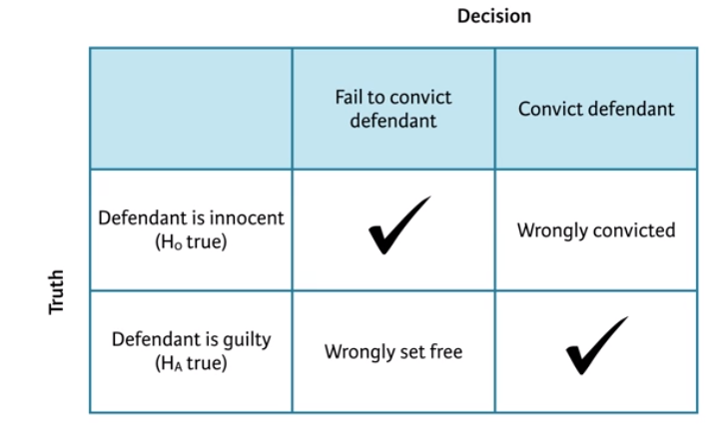
Insight from replications is limited
Any conclusion can describe reality correctly or incorrectly – in the legal system and in stats
Type I error
Type II error
In theory, we are more concerned about false positives than false negatives (No. Type I errors < No. Type II errors)
So should see more somewhat more replications that wrongly fail to confirm findings than findings that are correctly debunked by a single replication → but that will be balanced once published

Slide 28
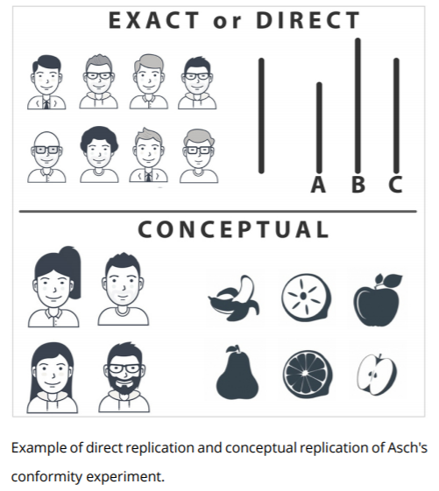
Types of replication
Direct: follows original protocol in as far as possible
Conceptual: tries to capture the idea in a different way

Slide 29
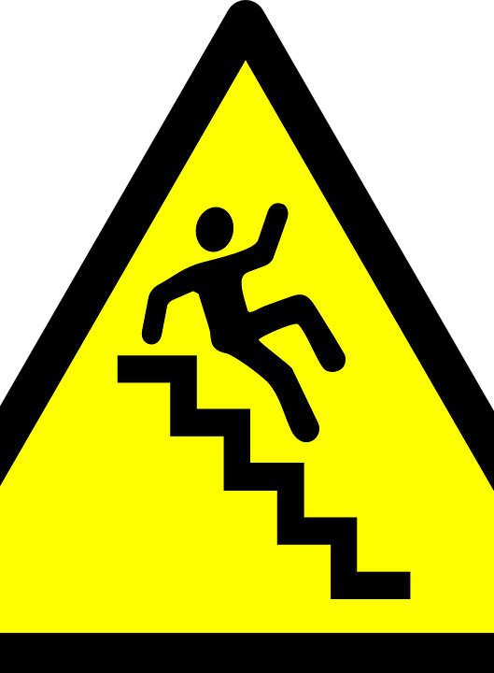
Why do we get so many false positives?
Fabrication (limited!)
Data analysis
Publishing bias
A problem with statistics

Slide 30
Problems with data analysis
Fabrication of results (e.g., Michael LaCour)
‘p-hacking’: making analytical choices motivated by getting p below .05 (e.g., stopping data collection, excluding participants, removing outliers, transforming data, etc)
Garden of forking paths: wander around in your data, look for patterns, and then test promising ones for significance (strict rule: should not look at your data before making decisions on statistical tests)
“If you torture your data long enough, they will confess to anything.” -Ronald Coase
Notes:
https://fivethirtyeight.com/features/science-isnt-broken
In published science, p-values just under .05 are over-represented – no reason why that should be
Problem with how we interpret the threshold – makes sense to have an agreed language, but that doesn’t imply that there is a real difference between p = .049 and p = .051

Slide 31
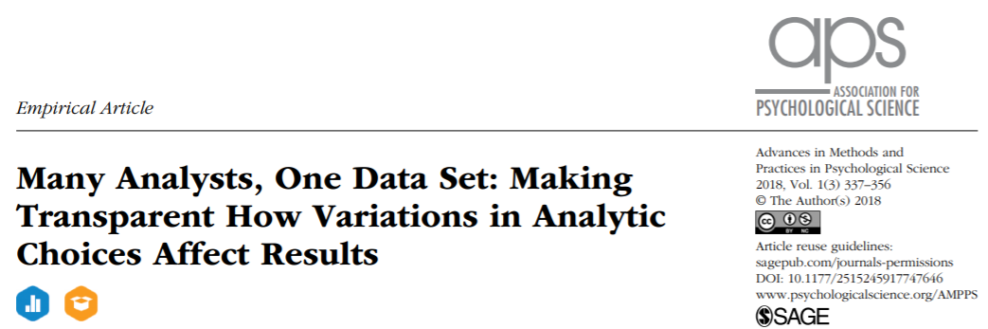
It is not just about (subtly) cheating with the data

Slide 32
Data analysis is a creative process
29 teams of statisticians analysed same dataset
Question: are soccer referees more likely to give red cards to dark-skinned than light-skinned players?
2/3 of teams found significant difference, 1/3 did not , large differences in effect sizes – and all used defensible methods
Usually, only few get done and one gets published – and it tends to favour the researcher
Notes:
Largest effect size: nearly 3x as likely.

Slide 33

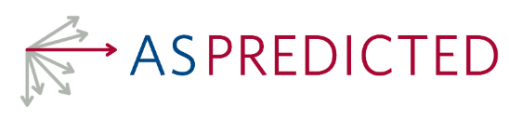
Importance of pre-registrations
Creates a public record before the start of data collection of all relevant analytical choices:
How much data will be collected?
How will the data be processed?
What specific statistical tests will be run?
Generally embargoed until publication, then visible
Prevents p-hacking and meandering in the garden of forking paths, unless people cheat

Slide 34
Reproducible research
Reproduction: independent researchers analyse the same dataset after publication
Movement argues that any reader should be able to reproduce analysis in an article, so publish
Traditional article
Data
Statistical analysis code
Any description needed to apply code to data
More advanced in many fields, e.g., Political Science, gaining momentum in psychology (challenge: use of SPSS)

Slide 35
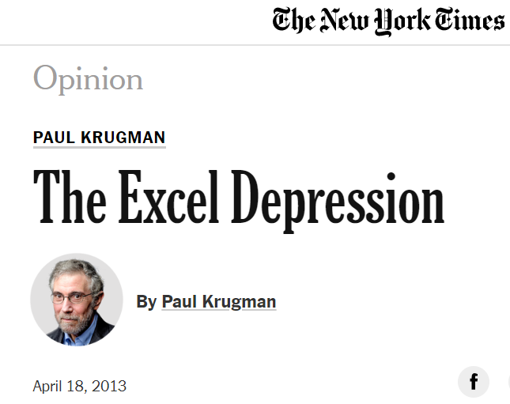
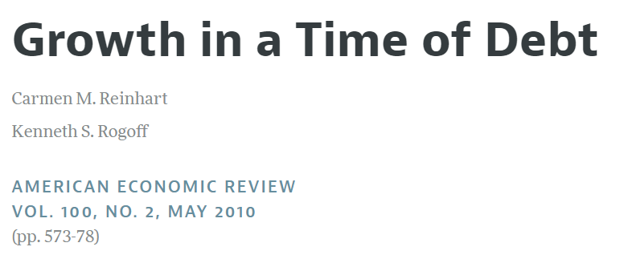
Key moment for reproducible research

Slide 36
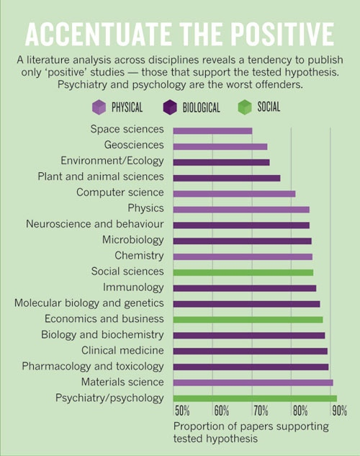
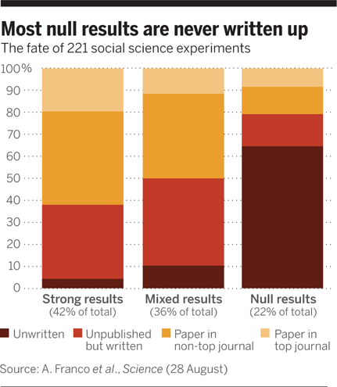
False positives due to publication bias
Notes:
Null results are important to know – especially when they contradict published positives, but also to avoid everyone going down the same wasted path
Opposite with replications
Small experiments with null results never get published – but small experiments in sexy field (social priming) will until a large replication attempt comes along

Slide 37
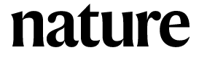
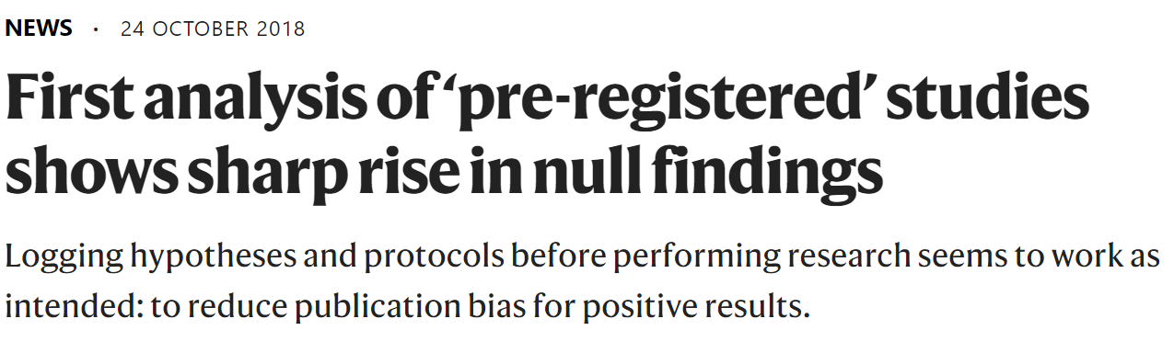

How to combat this?
If you read an experimental study that sounds interesting, you might want to have a look there

Slide 38
Two problems with standard statistics
Null-hypothesis significance testing mixes weakness of the study with absence of a difference
A small sample size with a large effect can have the same p-value as a large sample with small effect
So it is hard to assess what null findings are about
And:

Slide 39
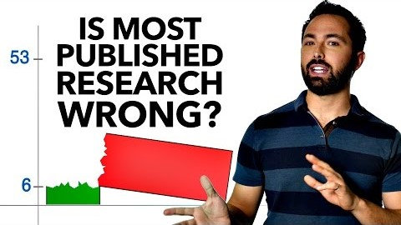

Slide 40
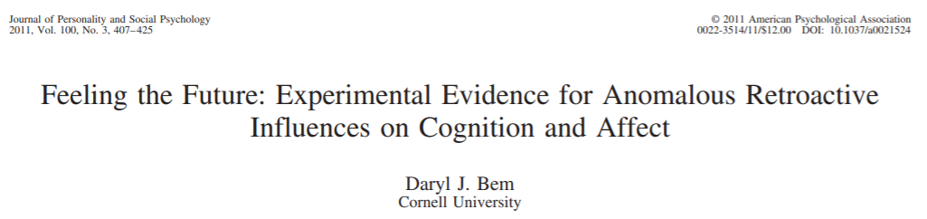
Task in pairs: Bem’s study
2 minutes to discuss
What, if anything, was wrong with publishing Bem’s study (based on what you know now)?
Notes:
JPSP is a very competitive journal -

Slide 41
Two problems with standard statistics
Null-hypothesis significance testing mixes weakness of the study with absence of a difference
A small sample size with a large effect can have the same p-value as a large sample with small effect
So it is hard to assess what null findings are about
And:
Does not consider prior probabilities, which we probably should for extremely unlikely hypotheses
Bayesian statistics helps with both issues – something for another course

Slide 42
What to do?
When you like an experiment, search for replications and meta-analyses
If there are none, treat it as an interesting idea
Don’t believe a theory that is based on a single experiment
Don’t treat a failed replication as a killer argument
Notice when articles report that the analyses were preregistered – it should increase our confidence

